Slide 1
Quality Center 10.0
Day-1
Kiran Sarpella

Slide 2
Topics Covered
Quality Center Introduction
Understanding the Quality Center Interface
Understanding Releases Module of Quality Center
Understanding Requirement Module Of Quality Center
Understanding the Business Components Module of Quality Center
Understanding the Test Plan Module of Quality Center
Understanding the Test Lab Module of Quality Center
Understanding the Defects Module of Quality Center
Generating Reports
Generating Graphs

Slide 3
Quality Center -Introduction
  Quality Center is an enterprise-wide application that is based on Java 2, Enterprise Edition (J2EE)technology.
  TestDirector™ streamlines the quality management process —from requirements gathering through planning, scheduling and running tests, to defect/issue tracking and management —in a single browser-based application.
  HP TestDirector for Quality Center supports high levels of communication and collaboration among IT teams.
  HP TestDirector for Quality Center enables your organization to digitize specific quality processes and procedures within the larger application lifecycle.

Slide 4
Quality Center-Usage
Business analysts define application requirements and testing objectives
Test managers and project leads design test plans and develop test cases
Test automation engineers create automated scripts and store them in the repository
QA testers run manual and automated tests, report execution results, and enter defects
Developers review and fix defects logged into the database
Project managers create application status reports and manage resource allocation
Product managers decide whether an application is ready to be released.

Slide 5
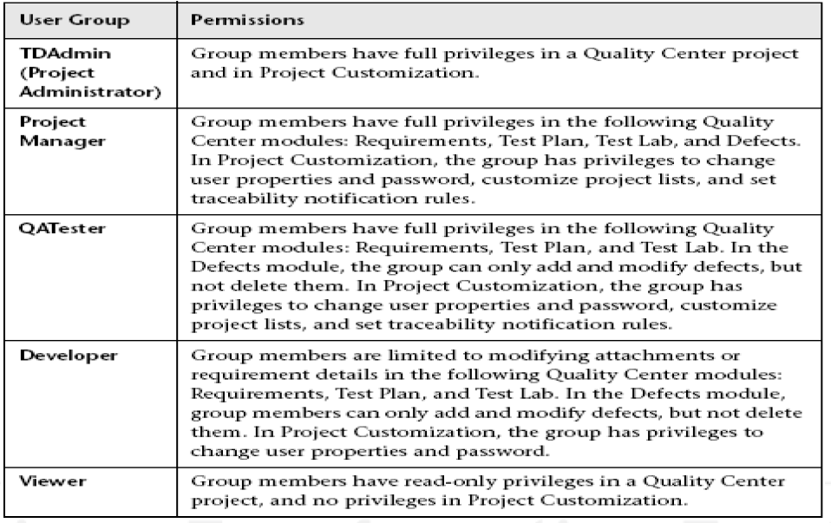
Quality Center-Usage
Quality Center has the following default user groups.

Slide 6
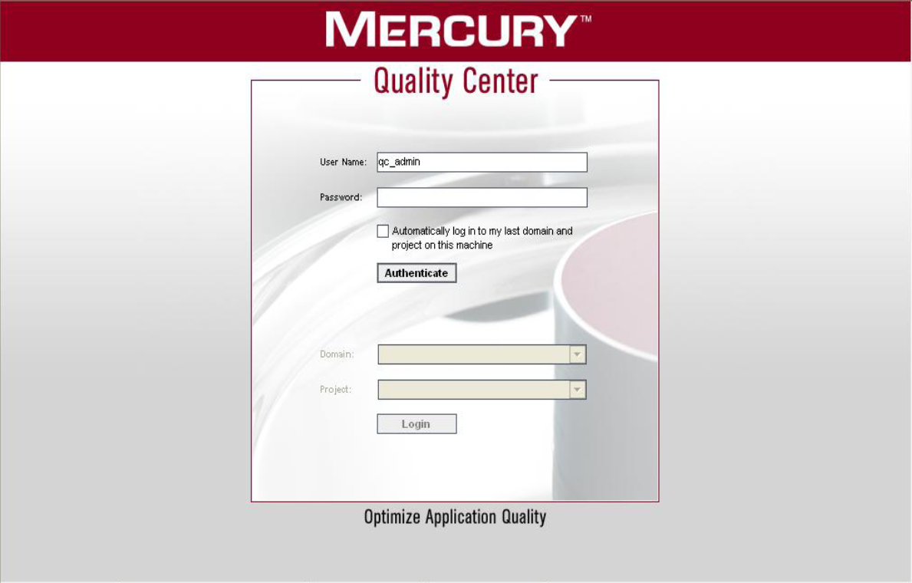

Slide 7
Quality Center -Features
Web based application with the following features
Releases
Requirement management
Business Components
Test plan
Test lab
Defects management

Slide 8
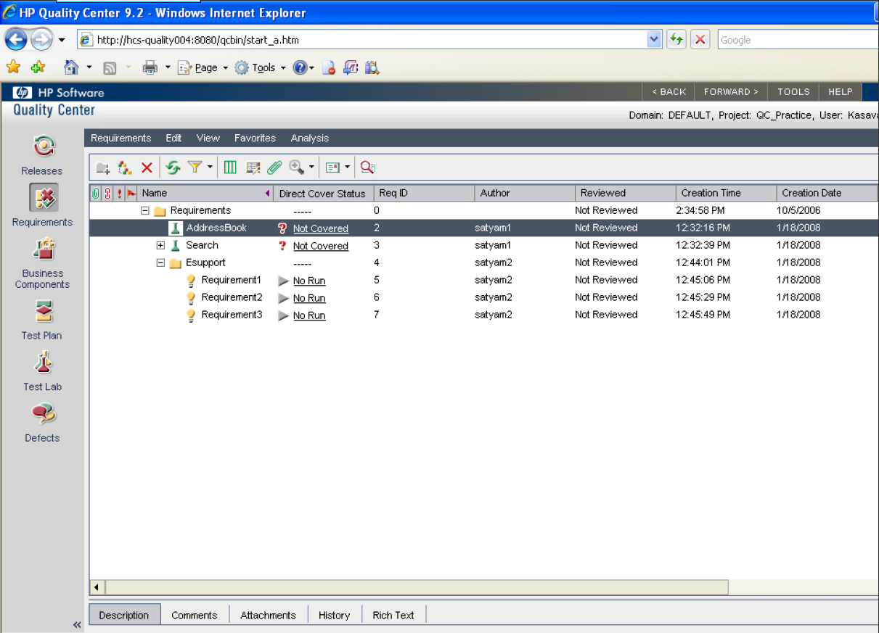

Slide 9
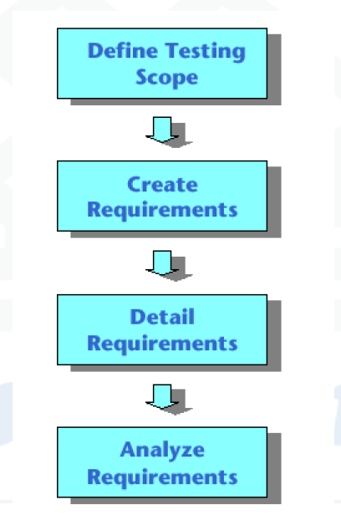
Requirement Specification (Requirements Module)

Slide 10
Testing scope
Gather all available documentations of the product under test.
Documents include
Business and Marketing Requirements
System Requirements Specs
Design Documents

Slide 11
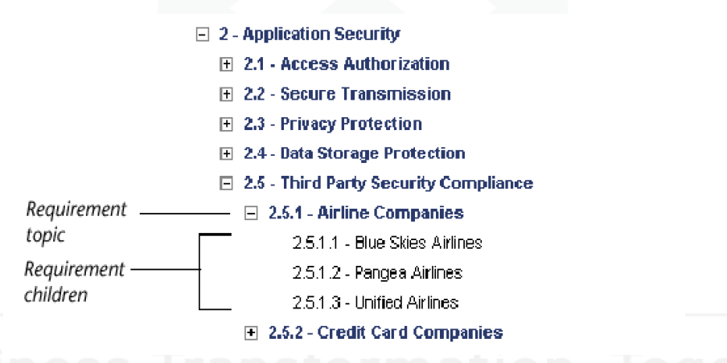
Defining Requirements
QA tester creates a hierarchical structure, defining the requirements.
For example, the requirement topic Application Security for a
Airline reservation system may be broken down into the following:

Slide 12
Analyze Requirements
QA managers review the requirements.
The requirement is assigned a reviewed status if it is approved.

Slide 13
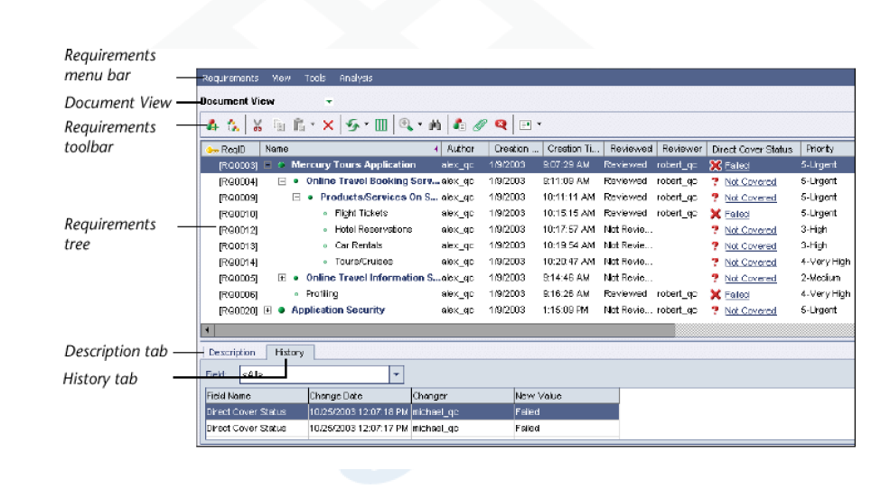
Requirement Module –Document View

Slide 14
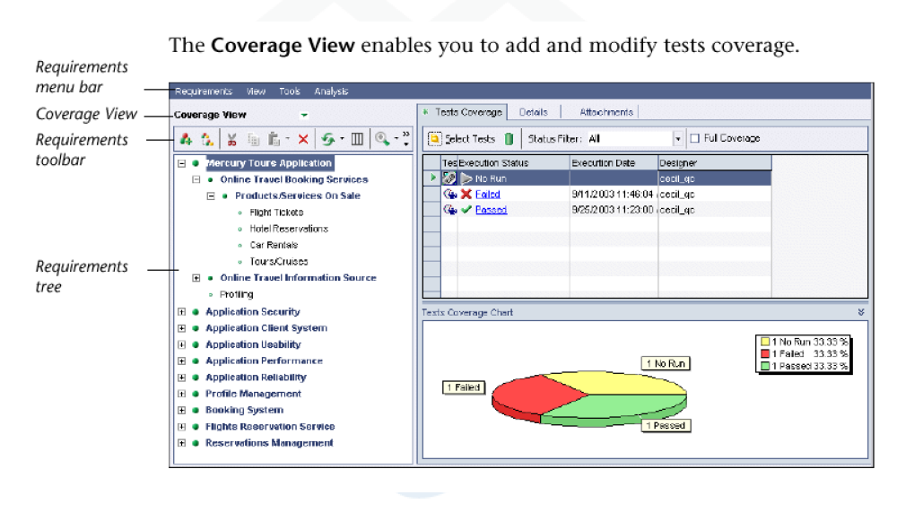
Requirement Module –Coverage View

Slide 15
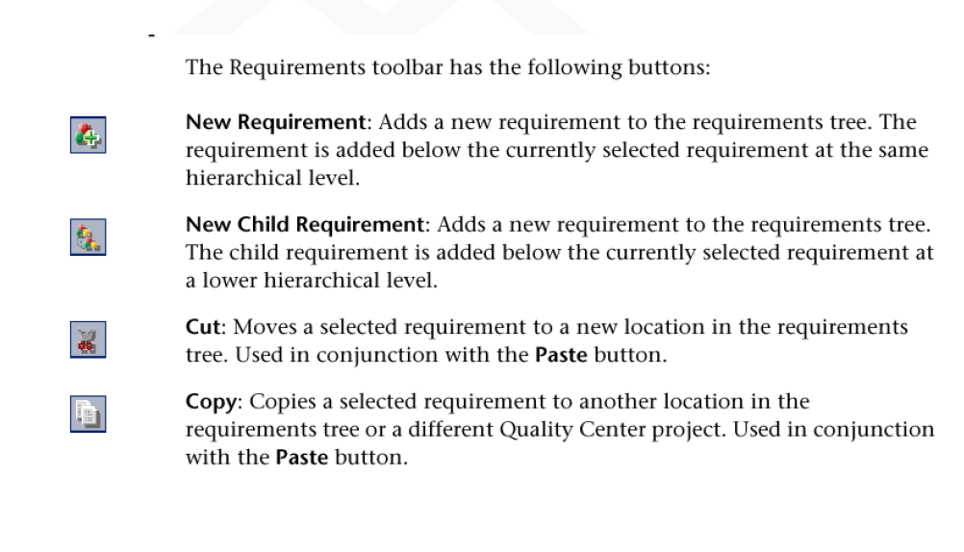
Requirement Toolbar

Slide 16
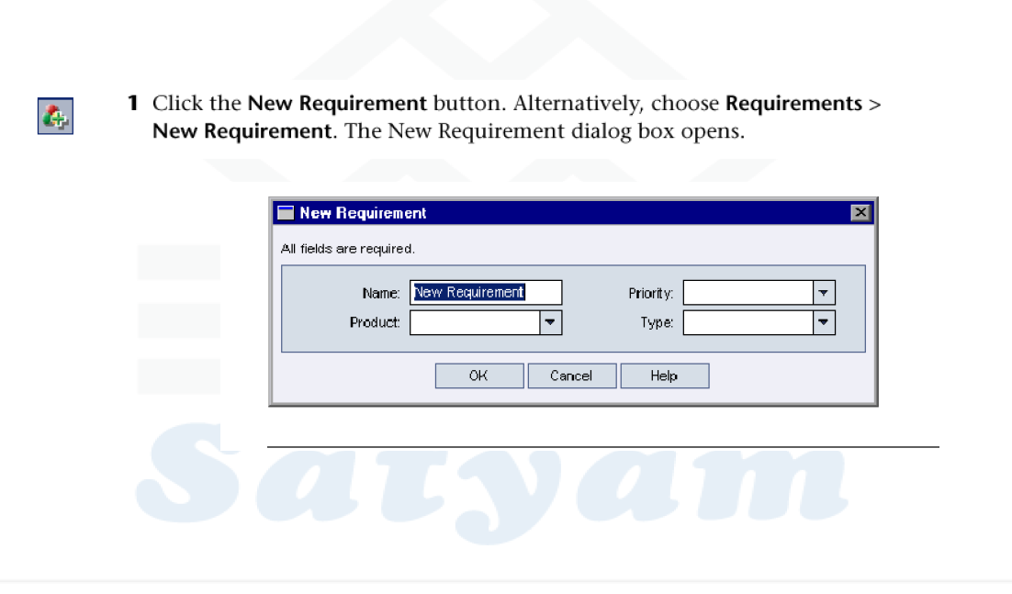
New Requirement

Slide 17
New Requirement
Name the requirement
Fill the details for the requirement
Fill the Description using the Description Pane
Add an attachment to the requirement using the Attachment Button

Slide 18
Requirement Details
Author
Creation Date, time, etc
Direct Cover Status –States how its linked to the tests. By default it is Not Covered
Not Covered means it has not been linked to any test

Slide 19
Adding an attachment
Attaching a file
Attaching a snapshot
Attaching a URL
Attaching System Information
Attaching an Image from the clipboard

Slide 20
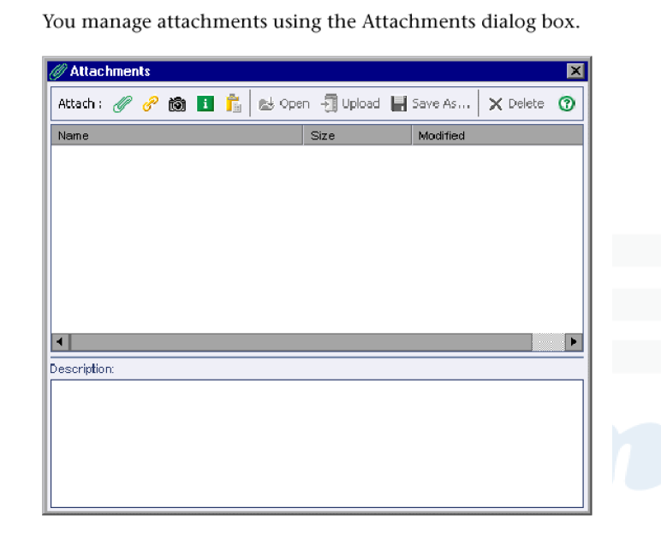
Attachments

Slide 21
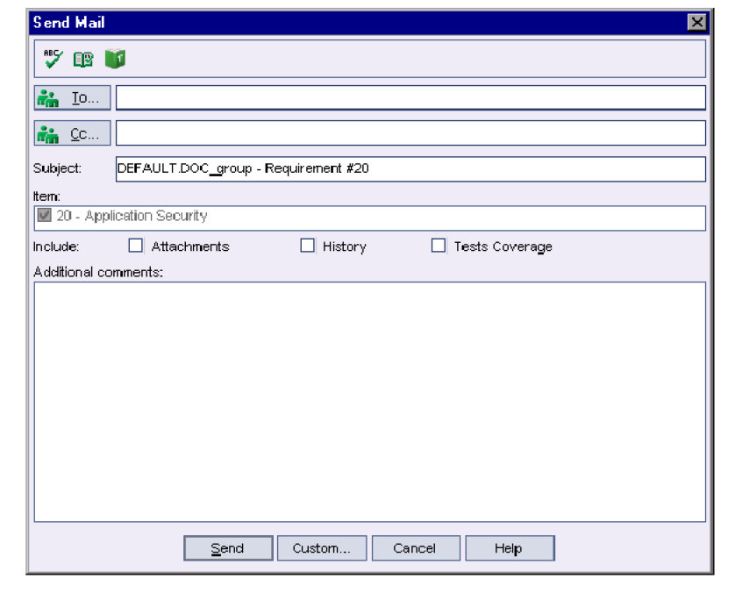
Mailing Requirements

Slide 22
Modifying Requirements
Renaming
Copying
Deleting
Modifying

Slide 23
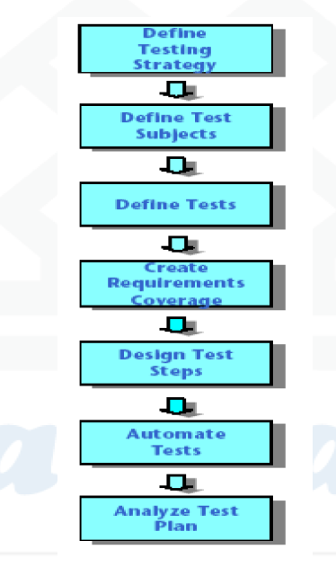
Planning Tests (Test Plan Module)

Slide 24
Thank you

